Slide 1
ONLINE FOOD ORDERING SYSTEM
ASHWINI DAKAI
2022-7601
EBEON0722629253

Slide 2
ABSTRACT:
The online food ordering system provides convenience for the customers. It overcomes the disadvantages of the traditional queuing system. This system increases the takeaway of foods than visitors. Therefore, this system enhances the speed and standardization of taking the order from the customer. It provides a better communication platform. the user’s details are noted electronically.
The online food ordering system set up menu online and the customers easily places the order with a simple mouse click. Also with a food menu online you can easily track the orders, maintain customer's database and improve your food delivery service. This system allows the user to select the desired food items from the displayed menu.

Slide 3
EXISTING SYSTEM:
In existing system for giving any orders users should visit hotels or restaurants to know about food items and them give order and pay advance.
In this method time and manual work is required. Maintaining critical information in the files and manuals is full of risk and a tedious process.

Slide 4
DISADVANTAGES:
More manual hours need to generate required reports
2. It is tedious to manage historical data which needs much space to keep all the past years applications, books etc.
3. User need to wait more time to get his application status.
4. Data is not in sync in case of manual system.
5. Co-ordination between various branches is very difficult
6. It is not secure to maintain important information manually

Slide 5
PROPOSED SYSTEM:
This online application enables the end users to register online, select the food from the e-menu card, read the E-menu card and order food online.
By just selecting the food that the user want to have.
The results after selecting the food from the E-menu card will directly appear in the screen near the Chef who is going to cook the food for you.
By using this application the work of the Waiter is reduced and we can also say that the work is nullified.
The benefit of this is that if there is rush in the Restaurant then there will be chances that the waiters will be unavailable and the users can directly order the food to the chef online by using this application.
The user will be given a username and a password to login.

Slide 6
ADVANTAGES:
1.The proposed system is automated that is faster than the existing manually maintained system and can handle data easily.
2.Computerization of the details of the menu and orders.
3.Maintenance time and cost are greatly reduced.
4.Accurate information can be generated easily and quickly at different levels.
5.Report can be generated easily and quickly.

Slide 7
MODULES
Administrator module
Customer Module
Manager Module
Meal deliver module

Slide 8
Functional Requirements
Administrator module :
This module is used to create usernames and passwords by admin.
Customer Module
View product’s list
Register
Place orders
Manager Module :
Create product categories and functionalities,
Edit / delete product categories and descriptions
Meal deliver module :
Functionalities provided:
View pending orders and delivery details
Confirm order delivery

Slide 9
Non Functional Requirements:
User Friendly Website
Browser Compatibility
High Quality and Performance
More Usability

Slide 10
Hardware Requirements:
Processor - intel
RAM - 4 GB (min)
Hard Disk - 160 GB
Keyboard - Standard Windows Keyboard
Mouse - Two or Three Button Mouse
Monitor - SVGA
➢ Monitor - SVGA

Slide 11
Software Requirements:
Operating System - Windows
Coding Language - Java/J2EE(JSP,JDBC)
Front End - HTML,CSS
Server - Apache Tomcat
IDE - Eclipse
Back End - MySQL

Slide 12
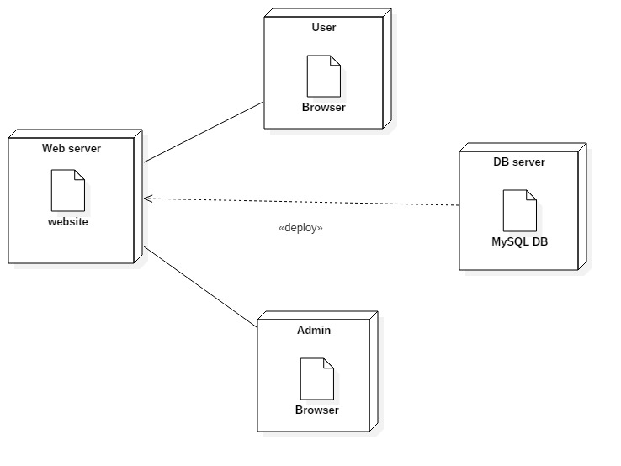
Compilation java Source code:

Slide 13
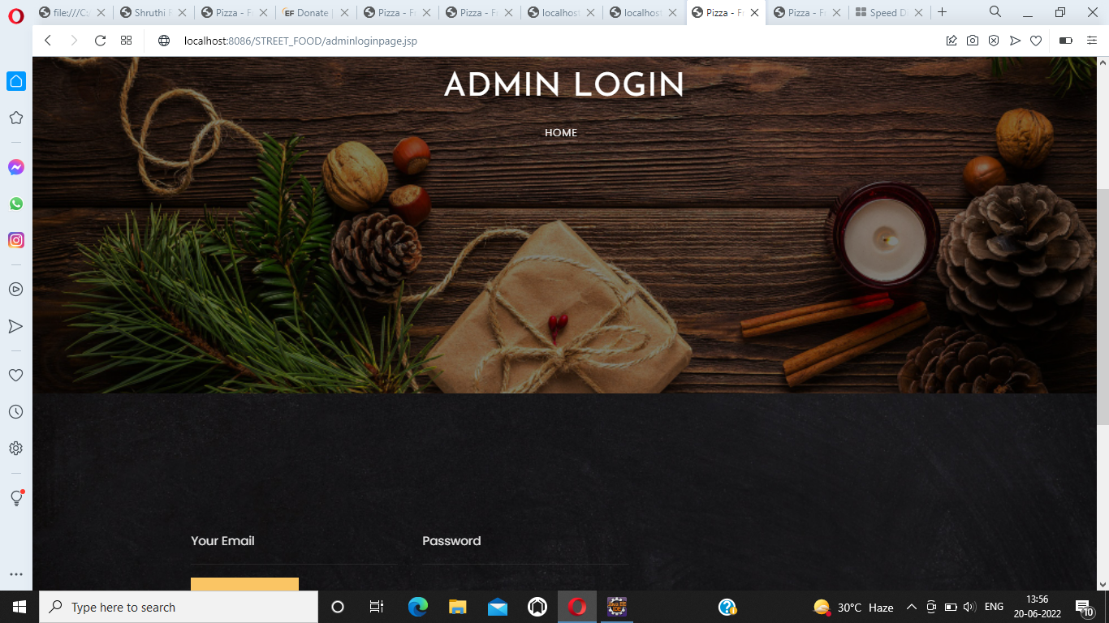
OUTPUTSCREENS:

Slide 14
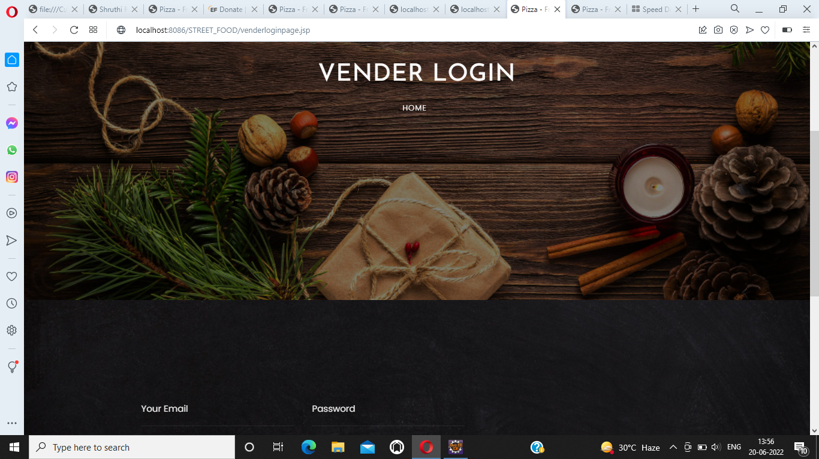

Slide 15
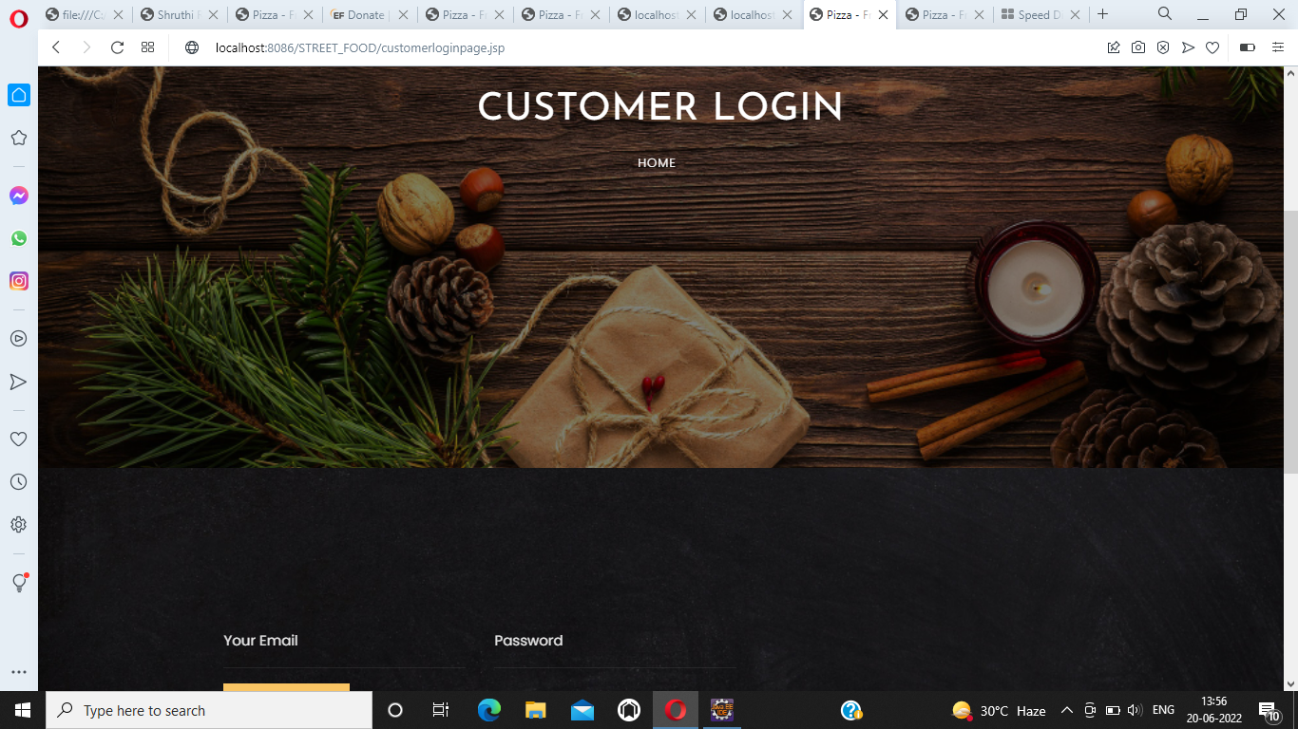

Slide 16
THANK YOU

